Slide 1
Egyptian Fraction
Algorithm
By: Nathan Groves

Slide 2
Categories
Egyptian Algorithm is a greedy algorithm that uses recursion to compute its output
Space Complexity : O(1)
Time Complexity -
Worst Case: O(n²)
Best Case: O(n)
Where n is the size of the input fraction

Slide 3
Purpose
The Egyptian Algorithm is a function to represent a rational number (a fraction) by summing the largest possible unit fractions derived from it. If the numerator is greater than the denominator, then the first term added must be greater than or equal to 1. (see example 4)
Unit fractions: a positive fraction with 1 in the numerator
Ex:
7/11 = 1/2 + 1/8 + 1/88

Slide 4
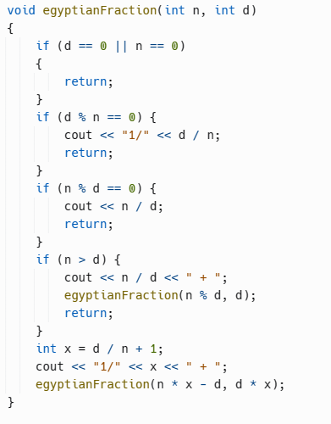
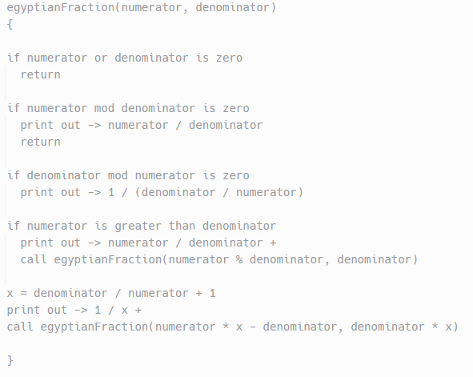
Code Representation
Pseudocode
Code

Slide 5
Example 1:
Initial Fraction: 6/14
Current Fraction: 6/14
Current Sum: 1/3
Since no if conditions apply:
x = 14 / 6 + 1 = 3 (remember to use integer division)
print out -> 1 / 3 +
call function again:
Numerator now equals 6* 3 - 14 = 4
Denominator now equals 14 * 3 = 42

Slide 6
Example 1:
Initial Fraction: 6/14
Current Fraction: 4/42
Current Sum: 1/3 + 1/11
Since no if conditions apply:
x = 42 / 4 + 1 = 11
print out -> 1 / 11 +
call function again:
Numerator now equals 4* 11 - 42 = 2
Denominator now equals 42* 11 = 462

Slide 7
Example 1:
Initial Fraction: 6/14
Current Fraction: 2/462
Current Sum: 1/3 + 1/11 + 1/231
since 462 % 2 = 0:
print out -> 1 / (462 / 2) = 1 / 231
Function Ends
Final Sum:
6/14 = 1/3 + 1/11 + 1/231

Slide 8
Example 2:
Initial Fraction: 41/55
Current Fraction: 41/55
Current Sum: 1/2
since no if conditions apply:
x = 55 / 41 + 1 = 2
print out -> 1 / 2
call function again:
Numerator now equals 41 * 2 - 55 = 27
Denominator now equals 55 * 2 = 110

Slide 9
Example 2:
Initial Fraction: 41/55
Current Fraction: 27/110
Current Sum: 1/2 + 1/5
since no if conditions apply:
x = 110 / 27 + 1 = 5
print out -> 1 / 5
call function again:
Numerator now equals 27 * 5 - 110 = 25
Denominator now equals 110 * 5 = 550

Slide 10
Example 2:
Initial Fraction: 41/55
Current Fraction: 25/550
Current Sum: 1/2 + 1/5 + 1/22
since 550 % 25 = 0:
print out -> 1 / (550 / 25) = 1 / 22
Function Ends
Final Sum:
41/55 = 1/2 + 1/5 + 1/22

Slide 11
Example 3:
Initial Fraction: 60/89
Current Fraction: 60/89
Current Sum: 1/2
since no if conditions apply:
x = 89 / 60 + 1 = 2
print out -> 1/2
call function again:
Numerator now equals 60 * 2 - 89 = 31
Denominator now equals 89 * 2 = 178

Slide 12
Example 3:
Initial Fraction: 60/89
Current Fraction: 31/178
Current Sum: 1/2 + 1/6
since no if conditions apply:
x = 178 / 31 + 1 = 6
print out -> 1/6
call function again:
Numerator now equals 31 * 6 - 178 = 8
Denominator now equals 178 * 6 = 1068

Slide 13
Example 3:
Initial Fraction: 60/89
Current Fraction: 8/1068
Current Sum: 1/2 + 1/6 + 1/134
since no if conditions apply:
x = 1068 / 8 + 1 = 134
print out -> 1/134
call function again:
Numerator now equals 8 * 134 - 1068 = 4
Denominator now equals 1068 * 134 = 143112

Slide 14
Example 3:
Initial Fraction: 60/89
Current Fraction: 4/143112
Current Sum: 1/2 + 1/6 + 1/134 + 1/35778
since 143112 % 4 = 0:
print out -> 1/ (143112 / 4) = 1 / 35778
Function Ends
Final Sum:
60/89 = 1/2 + 1/6 + 1/134 + 1/35778

Slide 15
Example 4 (Special Case):
Initial Fraction: 60/14
Current Fraction: 60/14
Current Sum: 4
since numerator is greater than denominator:
print out -> 60/14 = 4
call function again:
Numerator now equals 60 % 14 = 4
Denominator stays 14

Slide 16
Example 4 (Special Case):
Initial Fraction: 60/14
Current Fraction: 4/14
Current Sum: 4 + 1/4
since no if conditions apply:
x = 14 / 4 + 1 = 4
print out -> 1 / 4
call function again:
Numerator now equals 4 * 4 - 14 = 2
Denominator now equals 14 * 4 = 56

Slide 17
Example 4 (Special Case):
Initial Fraction: 60/14
Current Fraction: 2/56
Current Sum: 4 + 1/4 + 1/28
since 56 % 2 = 0:
print out -> 1 / (56 / 2) = 1/28
Function Ends
Final Sum:
60/14 = 4 + 1/4 + 1/28

Slide 18
Applications
Computer Science - Used in cryptography to create security key exchange protocols, as well as in scheduling problems
Art - Used by artists to create visuals representations of rational numbers
Physics - Seen in physical models such as in the calculation of the Casimir force between parallel plates in quantum field theory
Mathematics - Used to divide quantities into smallest possible sub-quantities

